Slide 1
Online Guidance
edgehill.ac.uk

Slide 2
Before we begin…
Thank you for agreeing to mentor an Edge Hill University trainee teacher. Your professional expertise and knowledge makes an enormous difference to the development of Edge Hill University’s trainee teachers. We recognise that it is this collaborative training partnership between partner settings, results in good and outstanding teachers who go on to make such a positive difference in children’s lives.
The mentor’s role is incredibly rewarding, but it is also hard work and this guidance will help you to understand the scope of the role, how to do it well and where to get help when you need it.
By agreeing to host a trainee on their professional practice, placement schools must agree to the roles and responsibilities as set out in the Partnership Agreement accessed by the link below:
https://www.edgehill.ac.uk/educationpartnership/partnership-agreements/
edgehill.ac.uk

Slide 3
Overview of paperwork in this guidance
Checklist for mentor
Learning and Teaching Evaluation Record
Interim Report
End of Practice Report
Additional information including Programme Handbooks are found on the Faculty of Education website and the latest version of all of the above documents are stored in the departmental areas of the website:
https://www.edgehill.ac.uk/educationpartnership/
edgehill.ac.uk

Slide 4
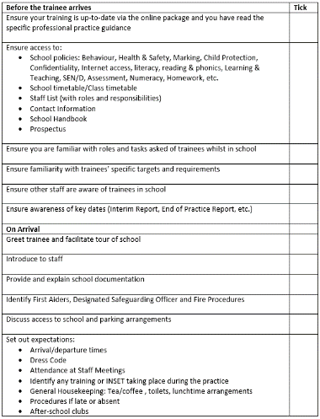
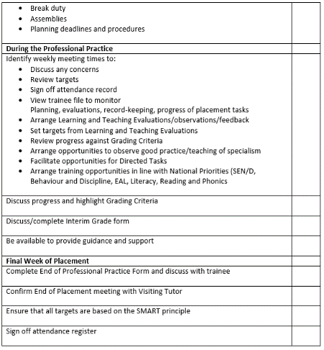
Overview- Checklist
This checklist will help guide you through the phases of the professional practice.
edgehill.ac.uk

Slide 5
First 2 weeks:
The first 2 weeks are very important in ensuring a smooth start to the Professional Practice. Prior to the Visiting Tutor’s initial visit please ensure that:
A timetable has been established for the trainee’s teaching, which includes opportunities to observe and complete the induction tasks outlined on page 8-9 of the Professional Practice handbook.
Planning expectations have been established – both the quantity and the timing of when it should be given to the class teacher.
Schemes of work (if any) are shared with the trainee.
The trainee has shared their targets with you.
The trainee has the following policies: Safeguarding (and information about the Safeguarding lead), Assessment, Behaviour, Equality and Diversity, Health and Safety and SEN/D. Also, a staff Code of Conduct or any similar document.
The trainee is organising their Professional Practice Resources according to the guidance on p8 and has made you aware of the Assessment and Grading criteria that should be completed weekly from when they begin teaching.
edgehill.ac.uk

Slide 6
The Learning and Teaching Evaluation- methods
Evaluation Methods: In order to make a judgement about the overall quality of teaching, the following activities need to be undertaken. | Discussion with Mentor / Teacher
 | Discussion with Trainee
 | Discussion with Learners
 | Discussion with TA / Other Adult
 | Learners’ responses within in the lesson and in their books / work
 | Quality and impact of Trainee’s marking and feedback
 | Trainees’ assessment and planning records in their files
 | Trainee’s own evaluation of their impact on Learners’ progress and learning over time
 | Observation of teaching and learning Between 20 and 30 minutes
edgehill.ac.uk

Slide 7
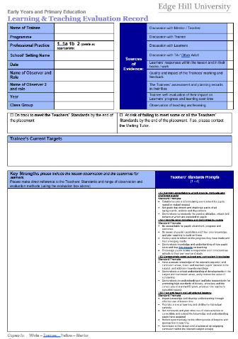
Learning and Teaching Evaluation record page 1
Tick all evidence seen as part of the observation process
Prior to the lesson, use the trainee teacher’s current targets as a focus for the lesson.
Record strengths against the Teacher Standards (TS) prompts. Record the TS in brackets.
edgehill.ac.uk

Slide 8
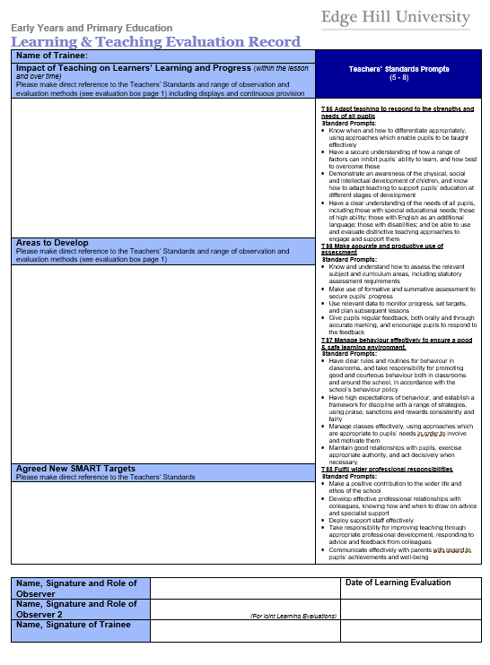
Learning and Teaching Evaluation record page 2
Reflect on the Learning Objectives for the lesson provide feedback about what children learned and how to improve learner progress linked to the Teacher Standards (TS) prompts.
Record specific areas to develop linked to the Teacher Standards (TS) prompts.
Set specific targets linked to standards.
edgehill.ac.uk

Slide 9
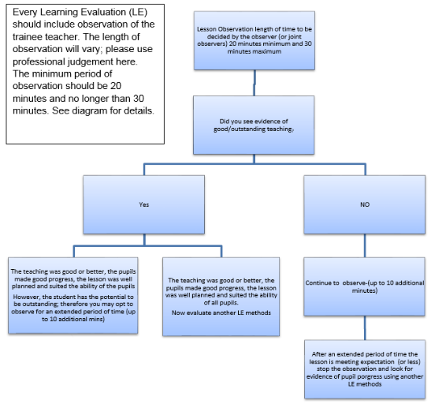
Lesson Observation within L&T Evaluation
Every Learning and Teaching Evaluation should include observation of the trainee teacher. The length of this observation will vary; you will need to use your professional judgement here. The minimum duration of an observation should be 20 minutes and the maximum, under normal circumstances, 30 minutes. See flow chart.
edgehill.ac.uk

Slide 10
Learning and Teaching Evaluation
Possible questions to ask yourself relating to the Teachers’ Standards
TS 1 – Set high expectations which inspire, motivate and challenge pupils
establish a safe and stimulating environment for pupils, rooted in mutual respect
set goals that stretch and challenge pupils of all backgrounds, abilities and dispositions
demonstrate consistently the positive attitudes, values and behaviour which are expected of pupils
Does the trainee:
expect each child to attain at his or her own level?
expects attention of each child as an individual?
presents a good role model; positive values, attitudes and behaviour demonstrated?
Children have good rapport with teacher?
Do the children:
Children can explain, individually, what they have learned and/or what they are doing and why?
Children feel challenged by the work set?
The Learning and Teaching Evaluation allows for the Mentor and Visiting Tutor to assess the trainee’s ability to plan, differentiate and deliver a lesson/a series of lessons. Language in your feedback must reflect the level of performance and should indicate their progress over time. Language in your feedback must reflect the level of performance and should indicate their progress over time.
edgehill.ac.uk

Slide 11
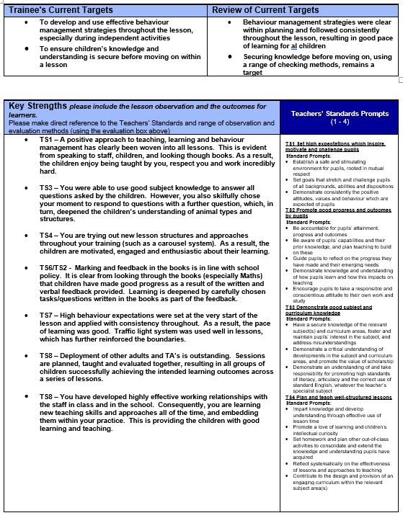
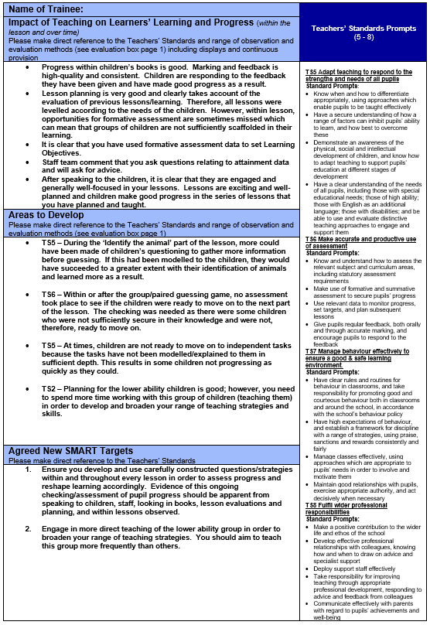
Learning and Teaching Evaluation
Example of a good Learning and Teaching Evaluation
– not all Standards need be evidenced.
edgehill.ac.uk

Slide 12
Giving feedback
Feedback is key in the mentoring relationship:
Feedback should be focused so that it is both supportive and developmental.
Targets should be negotiated with trainees and be specific to individual needs.
Please provide feedback to trainees at the earliest opportunity
Providing feedback to trainees:
Agree an adequate amount of time and a private place for debriefing
Give brief informal feedback at the end of the observation, keeping comments as positive as possible.
Debrief formally as soon as possible after the observation basing feedback on the written script, linked to the Teachers’ Standards
Use the Assessment and Grading Criteria consistently and celebrate trainee achievement.
In consultation with the trainee set SMART targets for future development, linking these to the Teachers’ Standards
Plan the focus together for the next observation.
Your valuable role as a mentor is to improve the practice of the trainee overall.
edgehill.ac.uk

Slide 13
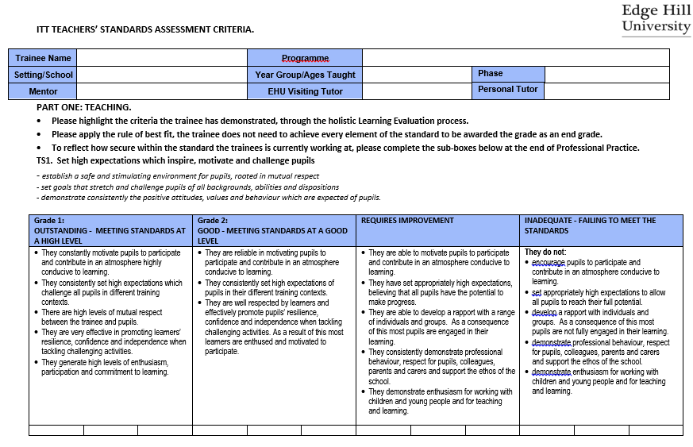
Assessment and Grading Criteria booklet
This document will allow the Mentor to track the progress of their trainee. This should be used to inform:
Each Learning and Teaching Evaluation/Observation Form
The Interim Assessment Form
End of Professional Practice Report Form
Mentors should decide how best to use this document. Some for example, may use it as an ongoing record for each trainee based on everything they have achieved throughout the Professional Practice, making it easier to set targets.
Criteria for TS1 shown here
edgehill.ac.uk

Slide 14
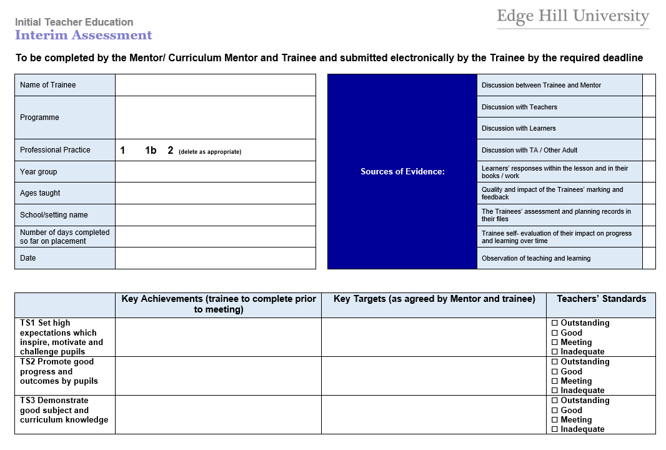
Interim Assessment (1)
This is discussed, agreed and returned to the University half way through the professional practice. It is used to comment and reflect on key issues of progression. (Page 2 follows)
edgehill.ac.uk

Slide 15
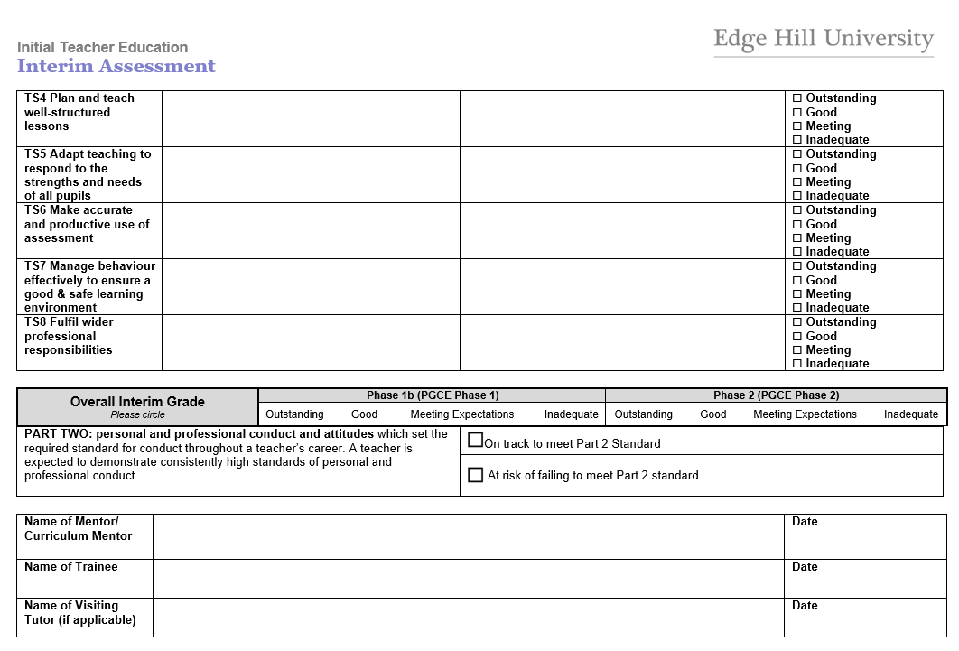
Interim Assessment (2)
edgehill.ac.uk

Slide 16
Interim Assessment Checklist
Prior to the Interim visit, the trainee writes down their key achievements on the Interim Assessment form and their agreed targets for the rest of the Professional Practice.
The highlighted Assessment and Grading criteria will guide the mentor’s initial assessment against the Teachers’ Standards. This is then confirmed after discussion with the Visiting Tutor.
As usual, the mentor conducts the Learning & Teaching Evaluation. The Visiting Tutor will observe jointly and advise about feedback.
After the 30 minute observation, the mentor, Visiting Tutor and trainee will all discuss feedback and agree targets. This requires an additional adult to supervise the class while this takes place.
Assessments against the Teachers’ Standards are agreed by the mentor and Visiting Tutor.
The trainee returns the Interim Assessment form via TurnitIn.
edgehill.ac.uk

Slide 17
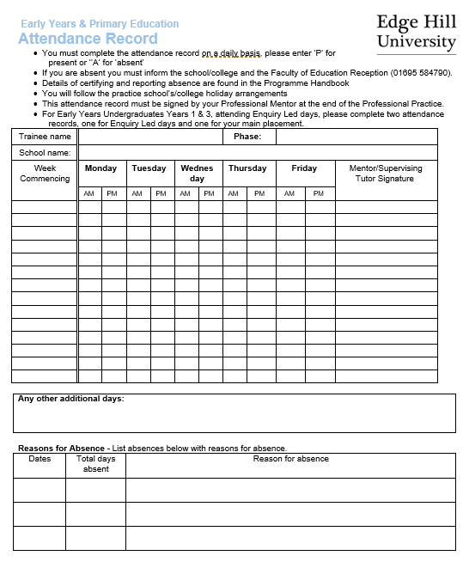
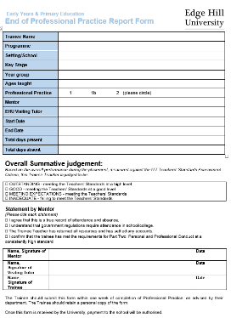
End of Professional Practice Report form (1)
The End of Professional Practice Report Form is completed by the Trainee, School-Based Mentor and Visiting Tutor at the end of the professional practice. It reflects the progression of the trainee throughout the duration of the professional practice.
The report is extremely important as it informs the next steps in the trainee’s training and Influences the trainee’s University reference.
edgehill.ac.uk

Slide 18
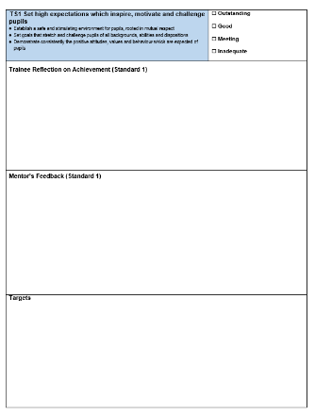
End of Professional Practice Report Form (2)
The End of Professional Practice Report Form continues with the Mentor’s assessments of the trainee’s meeting of each of the Teachers’ Standards (TS1 exemplified here):
edgehill.ac.uk

Slide 19
Trainees who are ‘Cause for Concern’
A trainee becomes a Cause for Concern if they are at risk of failing the Professional Practice and identifies additional support with regular reviews for at least a two-week period.
Time limited targets will be set to support the trainee in making progress. These will be reviewed regularly. If the Mentor and/or Visiting Tutor consider the trainee is still not making sufficient progress towards the targets that have been set or that it is not likely the trainee will achieve the minimum requirement for the Professional Practice, the trainee will be informed the Professional Practice has been unsuccessful and the practice will be terminated.
The trainees is then invited to attend a supportive Departmental Progress Meeting, to discuss next steps.
If you feel a trainee has become a Cause for Concern:
Contact the Visiting Tutor immediately
The Visiting Tutor will complete the appropriate document and together with the mentor and trainee, will set appropriate targets.
edgehill.ac.uk

Slide 20
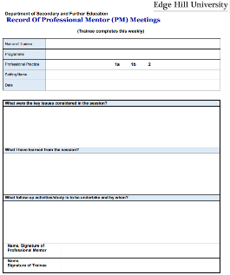
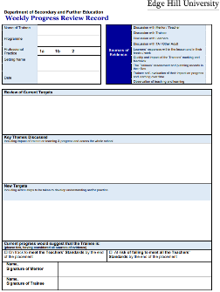
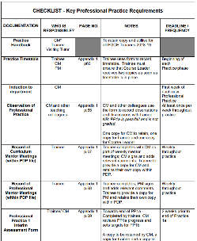
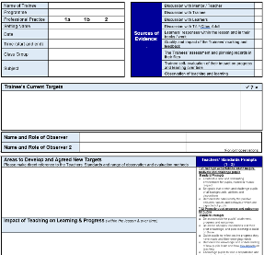
The trainee practice file
Throughout their practice trainees maintain a file of evidence that helps them to plan, teach and track personal targets. The evidence they collect will help demonstrate that they have met the Teacher Standards.
Full details of the contents of this file is contained in the Professional Practice Handbook. Essential elements are:
Records of meetings with School-based Mentor – especially targets set
Planning & Assessment Documents
Lesson Observations
edgehill.ac.uk

Slide 21
Further Training Opportunities
The University provides training, conferences and network events at which all our School-based Mentors are welcome.
There are also many other opportunities for engagement with the Faculty. Please contact us for further advice.
Lorraine Partington (Head of Partnership Development Team)
01695 650899
partingl@edgehill.ac.uk
Mark D Rawsthorn (Partnership Development Officer – Primary Education)
01695 657342
rawsthom@edgehill.ac.uk
Cathy Smith (Partnership Development Officer – Early Years Education)
01695 650811
smithcth@edgehill.ac.uk
edgehill.ac.uk

