Slide 1
Perceptions and impact of ten years of CAIeRO at the University of Northampton
Methodologies for measuring curriculum impact
Prof Alejandro Armellini Dean of Learning and Teaching
Julie Usher and Robert Farmer, Learning Designers and CAIeRO Researchers
University of Northampton
Ale.Armellini@northampton.ac.uk
@alejandroa

Slide 2
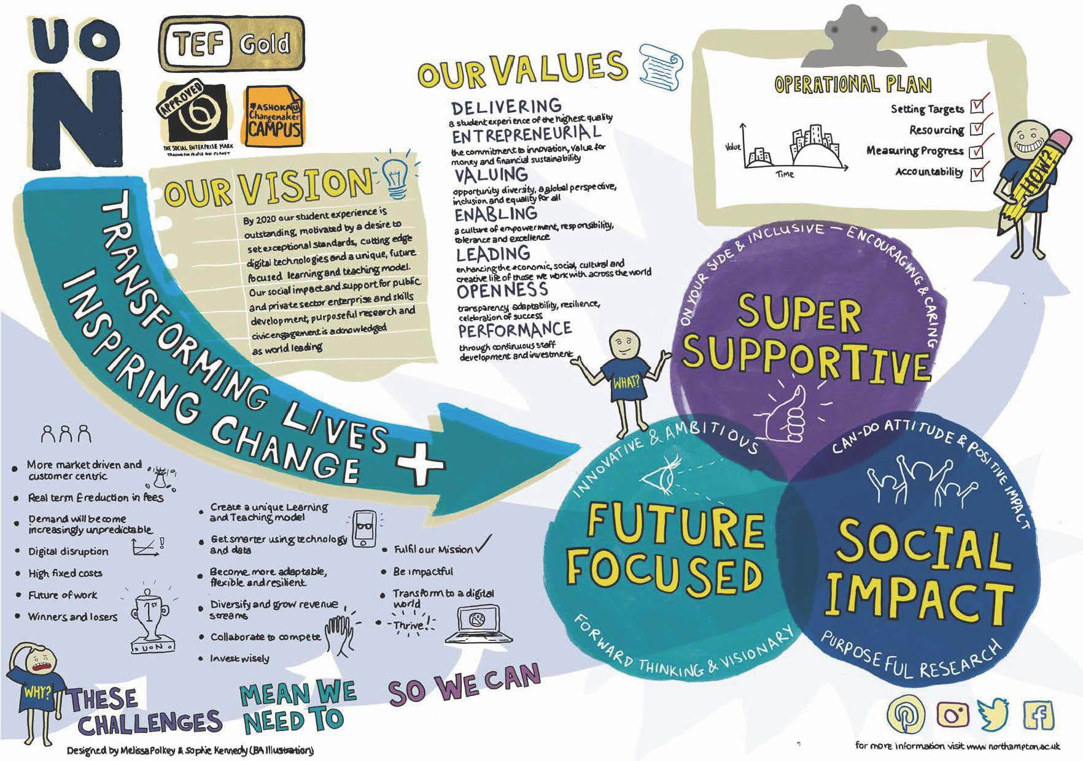

Slide 3
Active Blended Learning (ABL)
A course follows an ABL methodology if it:
Is taught through student-centred activities to develop knowledge and understanding, independent learning & digital fluency.
Has a core, collaborative face-to-face component, explicitly linked to learning activity outside the classroom.
Helps to develop autonomy, Changemaker attributes and employability skills.
Source: ILT website

Slide 4
What are the dimensions of a sound pedagogic “blend” in blended learning?

Slide 5
Dimensions of the blend
Face-to-face
+
Online

Slide 6
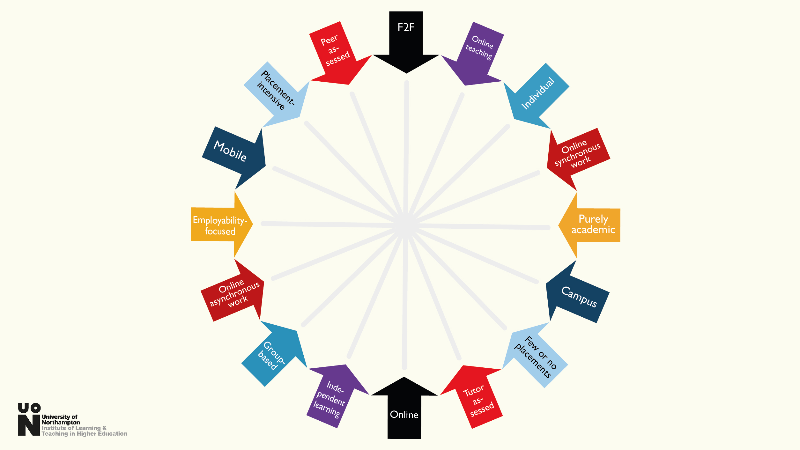

Slide 7
Dimensions
Face to face | Online
Online teaching | Independent learning
Individual | Group-based
Synchronous | Asynchronous
“Purely academic” | Employability-focused
Campus | Mobile
Tutor-assessed | Peer-assessed
Placement-intensive | Few or no placements
…

Slide 8
Digital resources
Tasks for sense-making
Analysis, discussion, reflection & goal setting
Consolidation & action planning
In and outside the f2f classroom
In and outside the f2f classroom
scaffold
Face to face,
small groups
Notes:
Ale

Slide 9
A course is not taught in ABL if:
It makes regular use of non-interactive lectures, or
The VLE (or LMS) is primarily a content repository, or
Online activity is merely an add-on to the face-to-face sessions, or
There is no evidence of systematic enhancement.

Slide 10
ABL is our new normal
ABL is not something we do in addition to our regular teaching: it is our standard approach to learning and teaching at Northampton.

Slide 11
April 2018
97% of all our modules have been designed or redesigned for ABL

Slide 12
Scaling up ABL
Our approach is
Explicit
Deliberate
Evidence-based

Slide 14
CAIeRO as a lever for pedagogic change
https://goo.gl/wgfoYm

Slide 15
What is CAIeRO?
Creating Aligned Interactive educational Resource Opportunities
What? A structured, two-day f2f workshop.
Purpose: to enable course teams to design (or redesign) for ABL.
Attendees: course team(s), learning technologist, students.
May also be attended by: external examiners, academic librarians, critical friends and other stakeholders, such as employers.
Facilitated by: trained facilitator, usually a Learning Designer

Slide 16
CAIeRO stages
blueprint
review & adjust
prototype
check reality
storyboard
Action Plan

Slide 17
CAIeRO timeline at Northampton
Introduction of Carpe Diem to Northampton
Externally-funded project, 2008
Adaptations and trials
2008-2012, 1 Faculty
Roll-out & CAIeRO identity
2012, all faculties
Scaling up for ABL
Since 2014
Research into the impact of CAIeRO
2017

Slide 18
CAIeRO timeline at Northampton
Introduction of Carpe Diem to Northampton
Externally-funded project, 2008
Adaptations and trials
2008-2012, 1 Faculty
Roll-out & CAIeRO identity
2012, all faculties
Scaling up for ABL
Since 2014
Research into the impact of CAIeRO
2017

Slide 19
Impact of CAIeRO on student learning?
CAIeRO (Carpe Diem)
Measurable impact? YES (design for ABL)
ABL
Measurable impact? YES (teaching practice)
Student Learning

Slide 20
Methodology (1)
Q (https://qmethod.org/)
Developed in the 1930s by William Stephenson
Aims to study subjectivity scientifically

Slide 21
Methodology (2)
Participants agree or disagree with a series of statements.
They place cards with the statements on a grid. The location on the grid indicates the extent to which they agree or disagree.
Responses are quantitatively analysed.
Participants with similar response patterns are grouped together.
Groups with similar feelings, beliefs or attitudes comprise a perspective.
Qualitative comments and contextual details were also gathered.

Slide 22
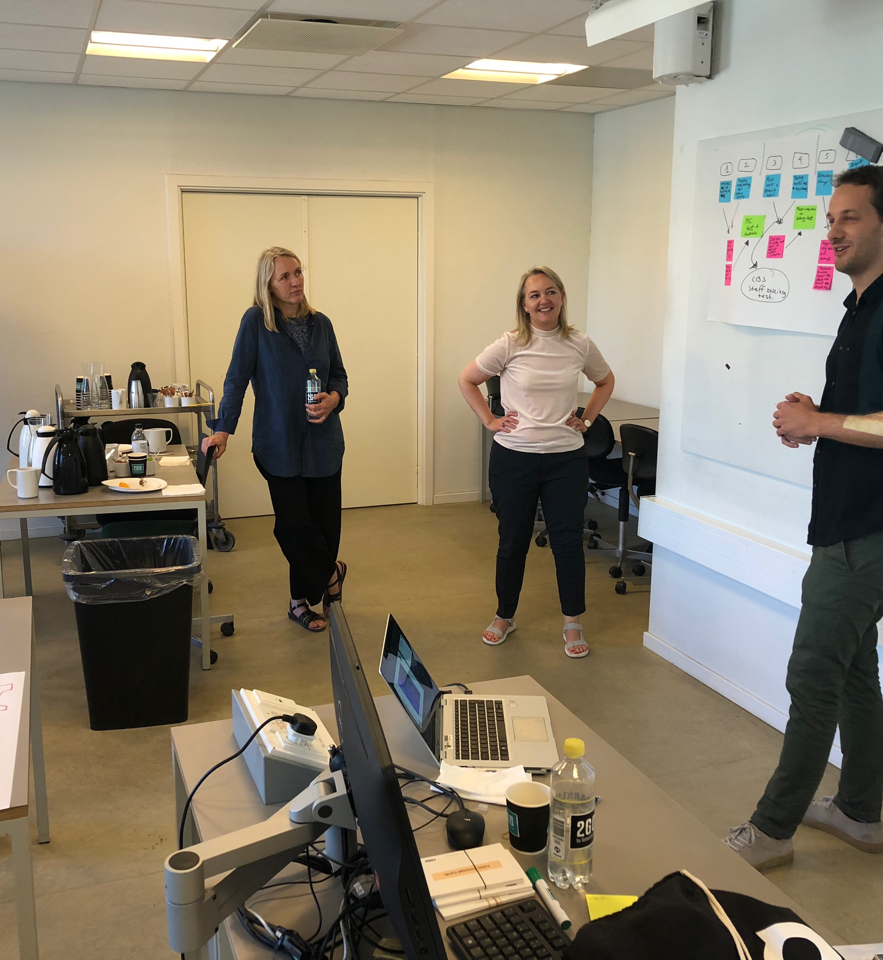
Four perspectives on CAIeRO
"CAIeRO is an opportunity for reflection on teaching and experimentation with teaching and learning activities."
CAIeRO is a positive learning experience, in particular as an opportunity to reflect on teaching and to consider teaching and learning as a more student-centred activity.

Slide 23
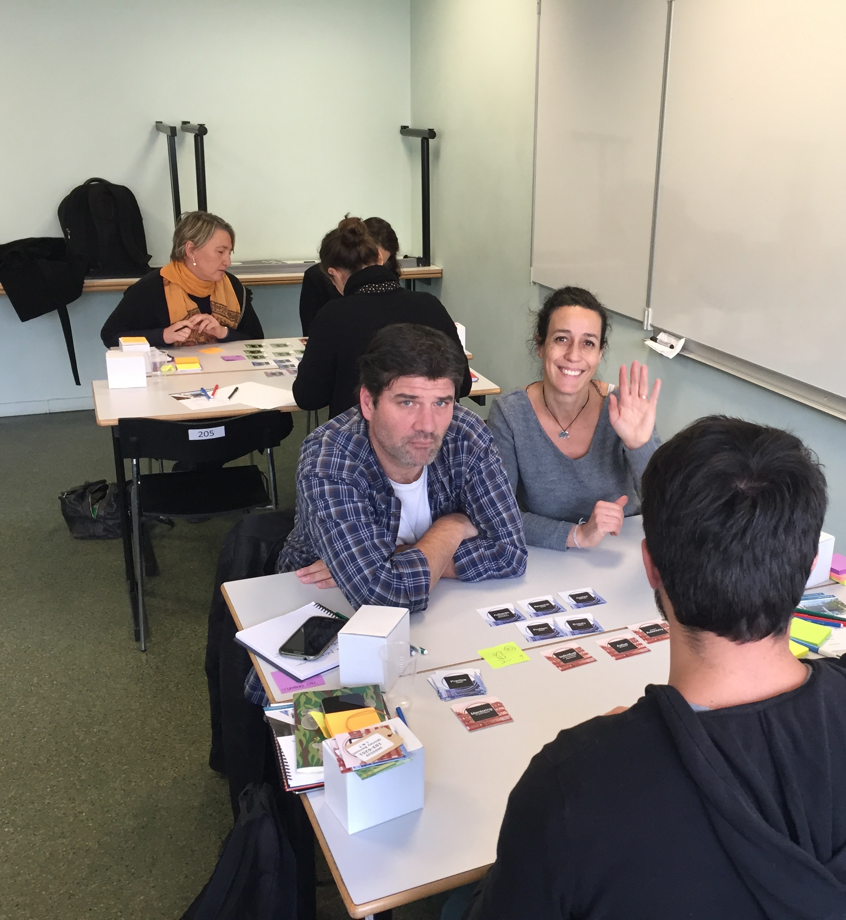
Four perspectives on CAIeRO
"CAIeRO is an opportunity for social learning and to build and strengthen relationships." These participants placed the most value on the collaborative aspects of CAIeRO.

Slide 24
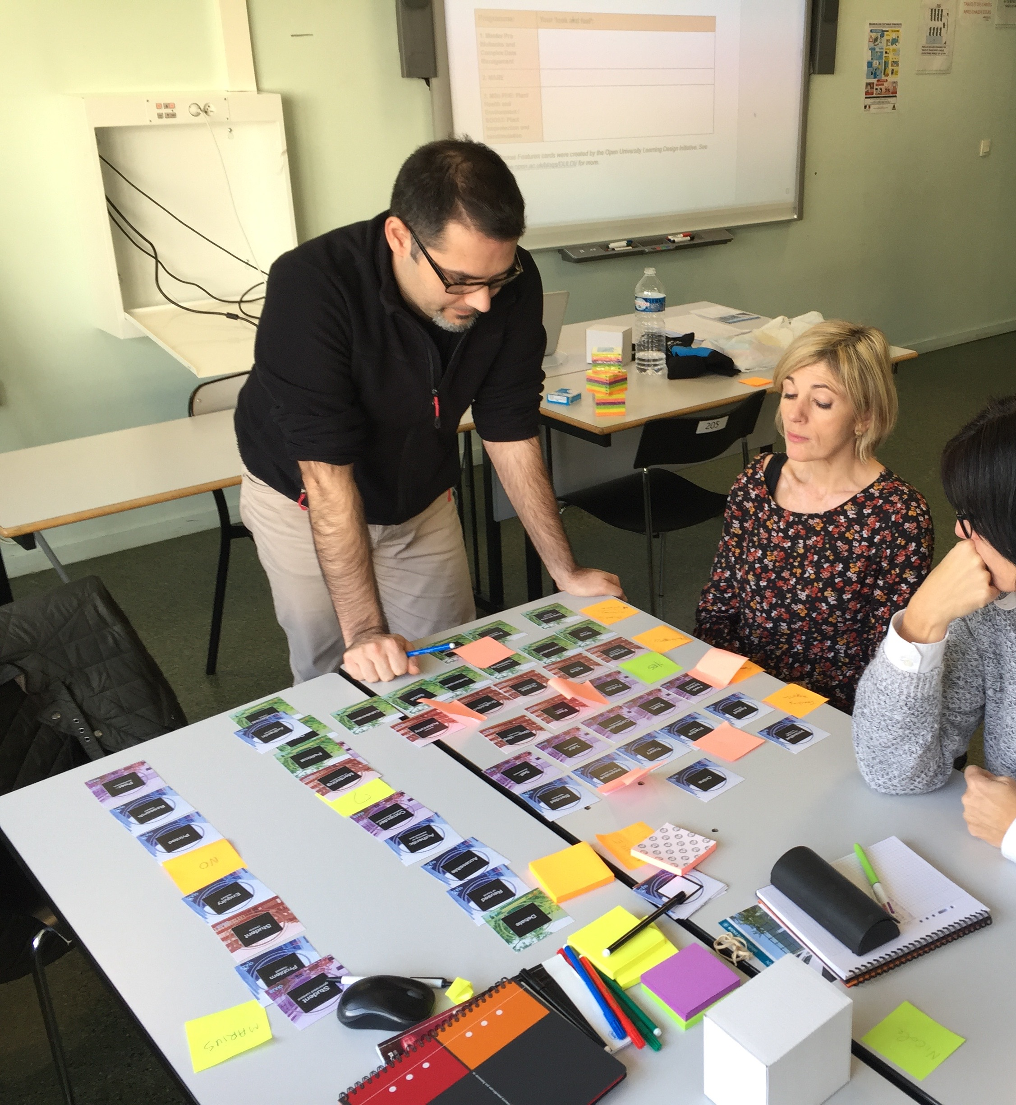
Four perspectives on CAIeRO
"CAIeRO is an opportunity to protect time for a structured and holistic design process." Participants in perspective 3 viewed constructive alignment as the most valuable element of CAIeRO, but also placed a high value on storyboarding.

Slide 25
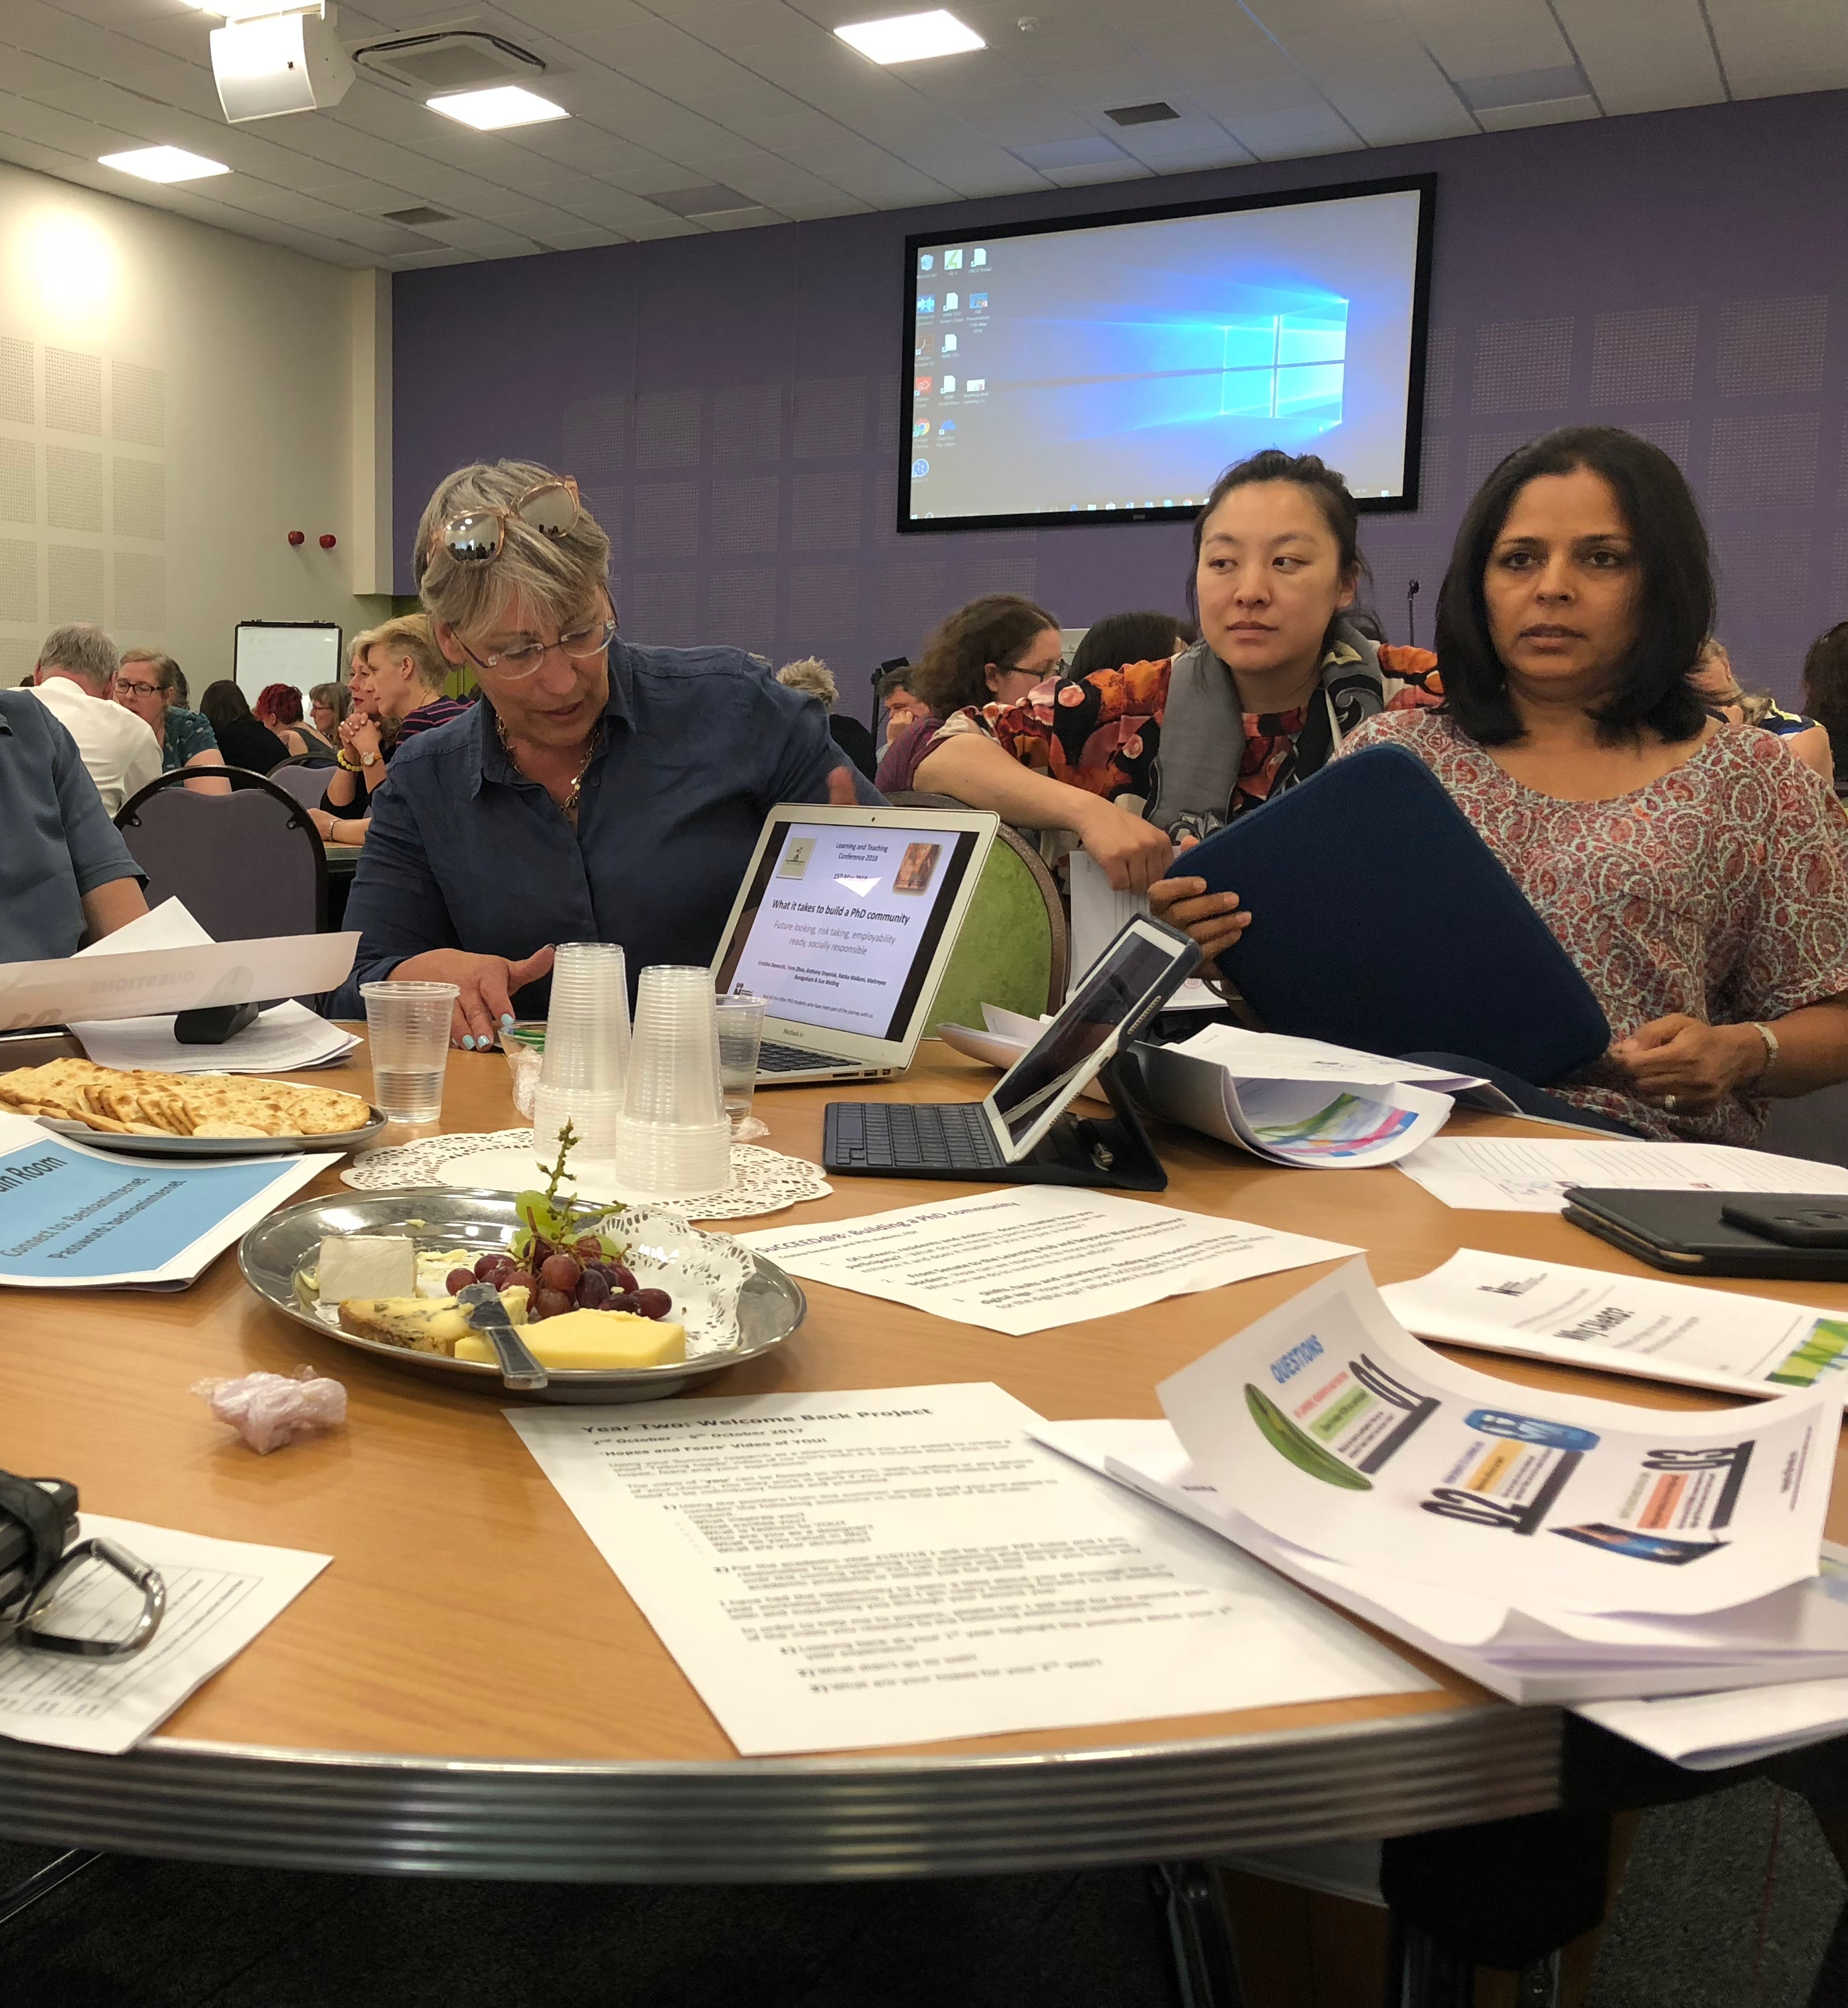
Four perspectives on CAIeRO
"CAIeRO is not perceived as a good use of time by staff who have been forced to engage with it." Those in this group felt that CAIeRO took up valuable time to complete a job that they could have done more quickly on their own.

Slide 26
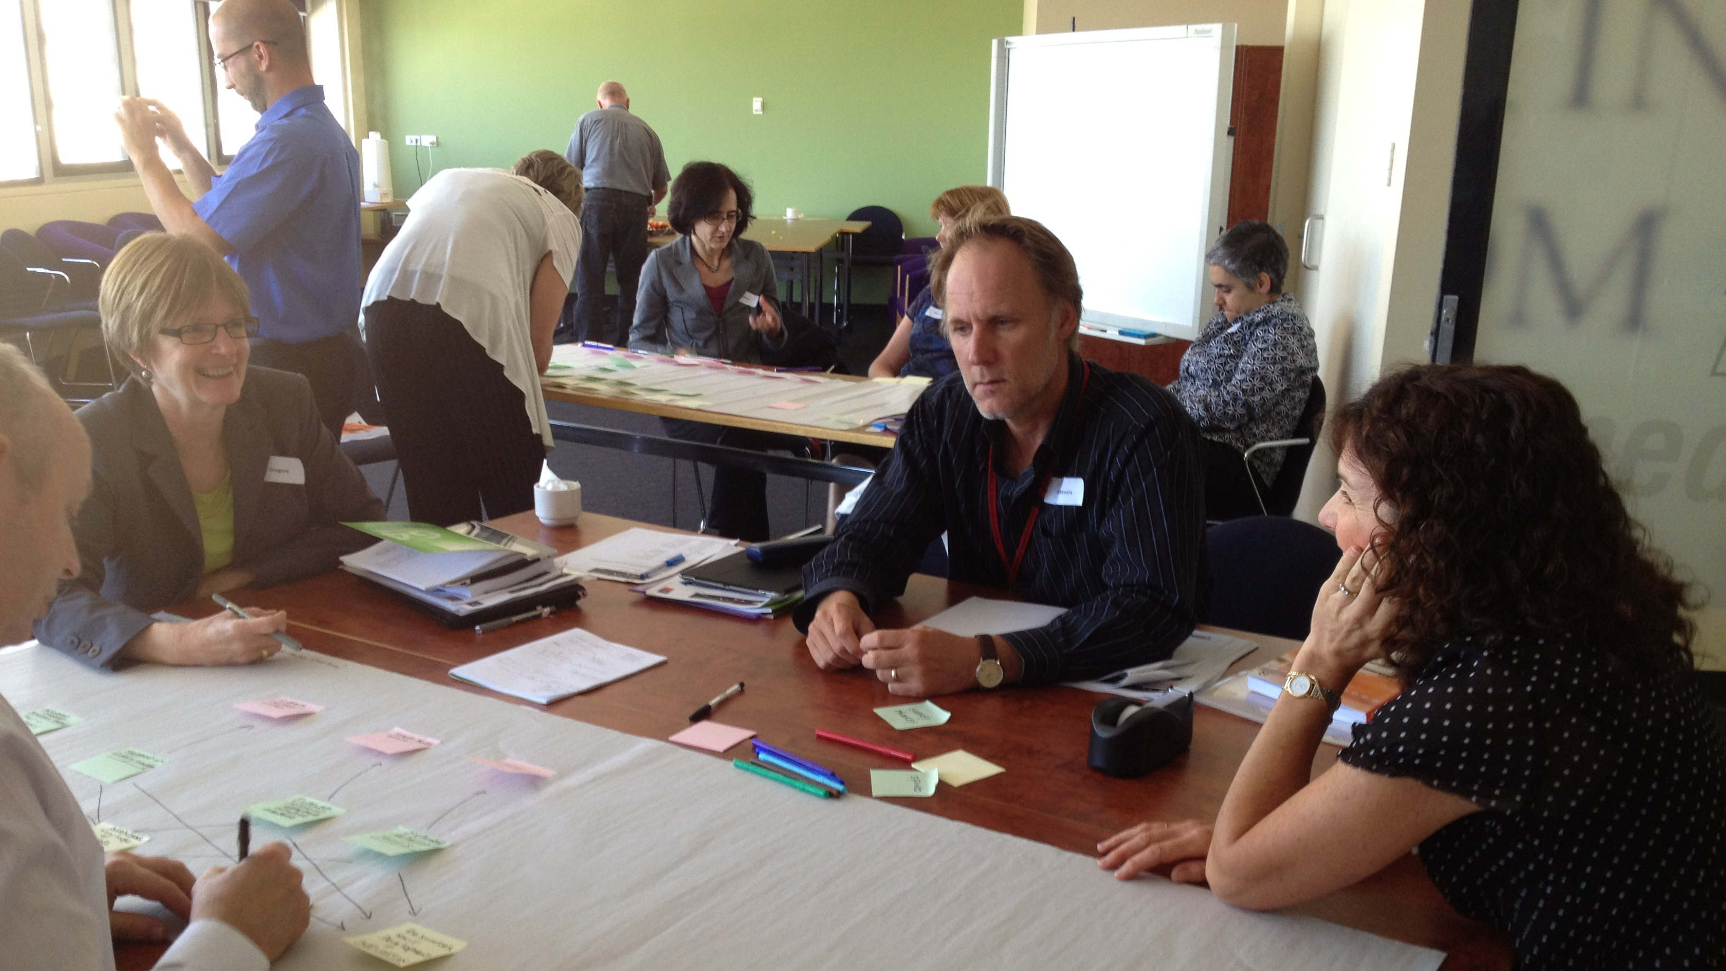
Conclusions (1)
CAIeRO is viewed by most participants as a valuable, reflective and effective process for designing active blended learning programmes and modules.

Slide 27
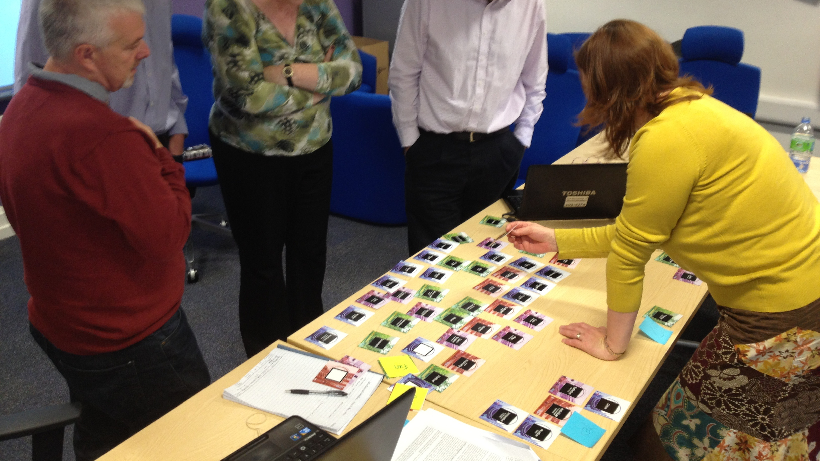
Conclusions (2)
The three most strongly agreed with statements about CAIeRO across all perspectives are:
CAIeRO encouraged me to reflect on and re-examine the way that I teach.
It has helped me to think about teaching in terms of the activities students do in order to learn, rather than the content I should deliver.
It helped me to align my learning outcomes with my teaching activities and my assessments.

Slide 28
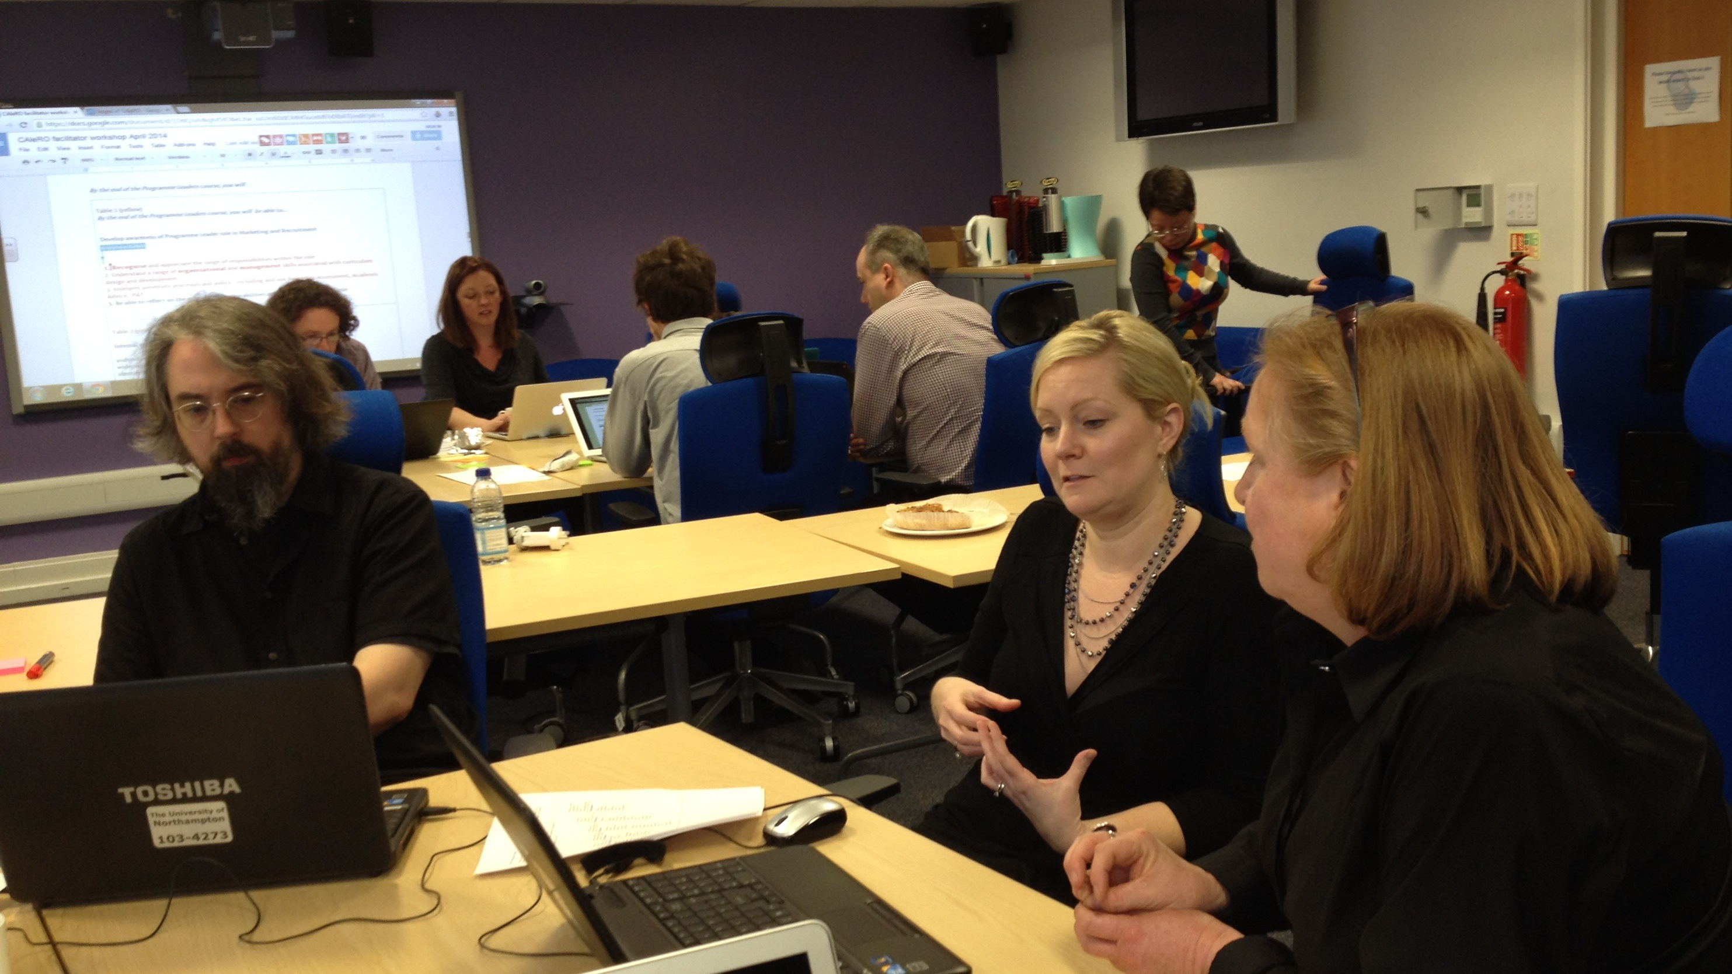
Conclusions (3)
Strong emphasis on collaboration and relationship-building
A valuable and effective development opportunity for all teaching staff, not just module leaders
Institutional support required for staff to invest time to undertake CAIeROs

Slide 29
Main limitation
Relatively low number of participants in the Q sorting process (n=22)

Slide 30
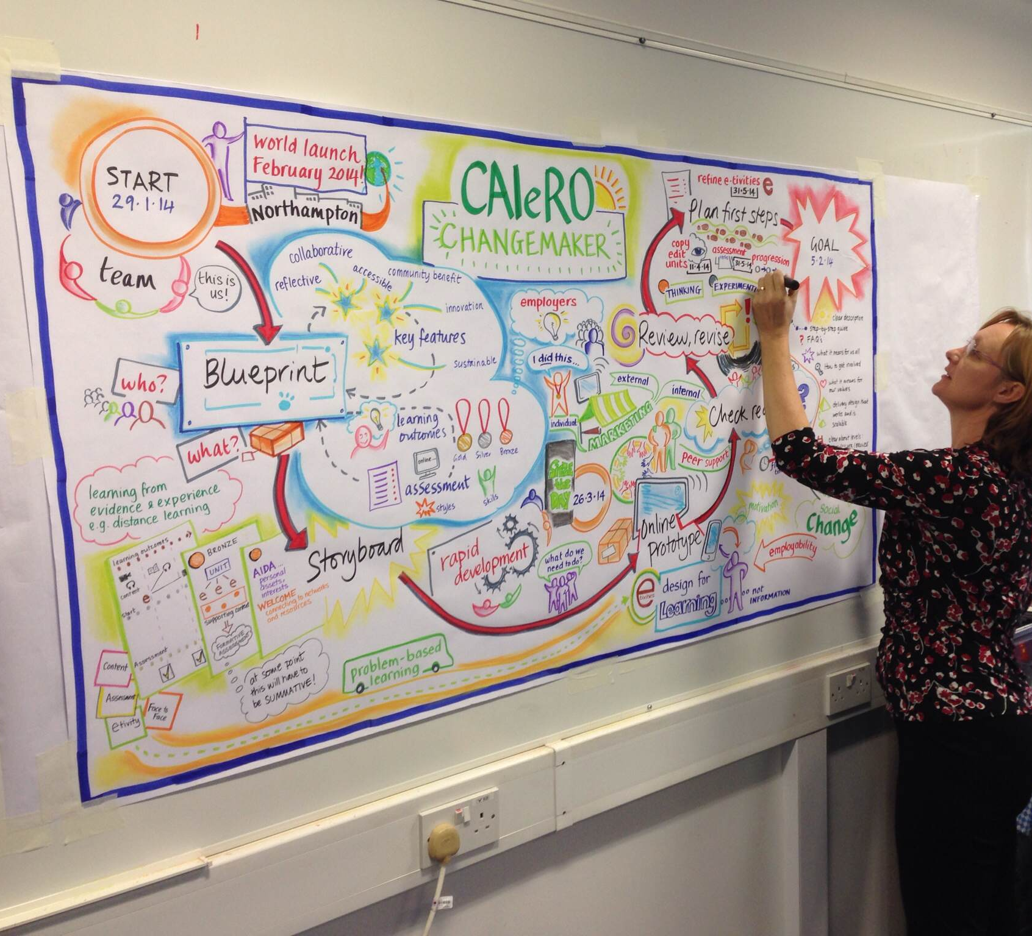
CAIeRO facilitation
Shadow and co-facilitate first (including micro-teaching)
Make good use of the pre-CAIeRO meeting to:
Negotiate goals
Adjust and tailor the workshop
Spot opportunities to add value
Anticipate problems and suggest solutions
Don’t facilitate in your own subject area

Slide 31
Representative quotes (1)
“CAIeRO provided an opportunity to focus on learning and teaching practice rather than subject content. It reminded me to start from the student.”
“The CAIeRO process has allowed me to consider and reflect on the ways students learn given the content and the context of the module, to promote engagement, interest and motivation to learn more and on a deeper level.”
“I would recommend CAleRO to others because [it] provides dedicated time to re-evaluating a module and physically being able to see where content fits from a student perspective and how this relates to learning outcomes and assessments.”

Slide 32
Representative quotes (2)
“Although a CAIeRO feels like a heavy time investment when you have to devote ring-fenced time to it in a busy diary, it is time very well spent.”
“I thought that while [CAIeRO] might reveal some useful ideas, it was going to take up two days unnecessarily. Having completed the process, I became a convert.”

Slide 33
Teaching quality for an outstanding student experience
An enhanced learner experience
CAIeRO: excellent design & teaching for active blended learning in small groups as standard
Responding to the student and staff voice: agency
An aligned framework of graduate attributes
CPD for staff aligned to professional standards for teaching (UKPSF)
Teaching as important as research (incl. pedagogic research) for career progression
Research
Impact assessment
Policy
Practice

Slide 34
Teaching quality for an outstanding student experience
An enhanced learner experience
CAIeRO: excellent design & teaching for active blended learning in small groups as standard
Responding to the student and staff voice: agency
An aligned framework of graduate attributes
CPD for staff aligned to professional standards for teaching (UKPSF)
Teaching as important as research (incl. pedagogic research) for career progression
Research
Impact assessment
Policy
Practice

Slide 35
Thank you
Prof Alejandro Armellini Dean of Learning and Teaching
Julie Usher and Robert Farmer, Learning Designers and CAIeRO Researchers
University of Northampton
Ale.Armellini@northampton.ac.uk
@alejandroa

