Slide 1
Edge Hill University – Taught degrees Framework
Claire Moscrop

Slide 2
Aims
Introduce Edge Hill University’s ‘Taught Degrees Framework’
Gain insight from delegates on how to engage departments in pre validation and periodic T+L reviews

Slide 3
Taught Degrees framework (TDF)
A set of guiding principles for the design of all undergraduate and taught postgraduate programmes validated by the University
‘Enabling, yet constraining’ –
Enabling through guidance around best practice for effective curriculum design
Constraining in that course teams are required to engage with a series of ‘lenses’ containing essential questions around teaching, learning, assessment, etc

Slide 4
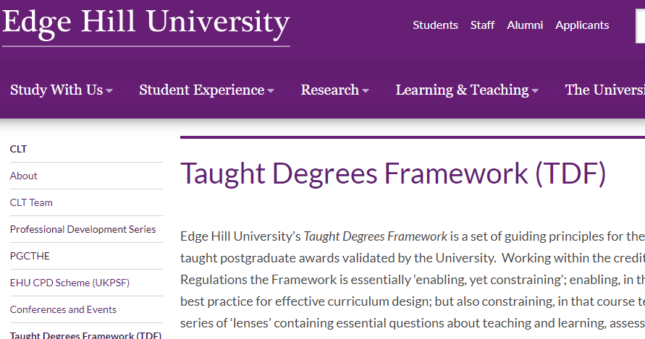
The ‘Lenses’
Graduate Attributes, Employability and Work-Related/Work-Based Learning
Induction and Transition
Learning, Teaching and Assessment
Education for Personal Development and Enhancement
Global Citizenship
Notes:
https://go.edgehill.ac.uk/display/ufr/Home

Slide 5
Challenges
Whilst Edge Hill provide this very structured approach to curriculum development and validation:
The work around TLA tends to be structured around validation documents and ‘matrices’ and ‘mapping’ exercises – creating robust TLA strategies at a programme level but with a lack of detail in rationale for TLA approaches within modules – especially in relation to formative assessment, feedback strategies, assessment literacy development, etc
Programme teams validating or re-validating programmes engage with the requested lenses of the TDF – but not all staff get involved in the process and are therefore unsure about rationale of some approaches – They are given modules to develop, often in a stand alone manner after validation
Senior Managers have admitted that there is sometimes a ‘drift’ away from initial TLA rationales in some modules, especially when modules are handed on to others over time

Slide 6
Questions
After identifying these challenges we would like to embed curriculum/TLA development days with departments to ensure all staff have a clear view of TLA processes, skills development, rationales, etc. So…
How do we do this without mandating that it should happen as part of validation? (or should it be mandatory?)
From your experience, how do we get departments to engage? At what stage?
What mechanisms do you use (or would you like to use) to prevent the ‘drift’ over time that some managers have identified?
How do we measure if interventions enhance the learner experience?
Priming for the workshop later! – What would ‘nirvana’ in curriculum development look like? What are the challenges and pitfalls? What/who are the enablers? What works for you? How do we know that our approaches enhance the learner experiences?
Post it notes

