Slide 1
Embedding Ethics and Professional Issues in the Computer Science
Undergraduate Curriculum
Floriana Grasso
University of Liverpool

Slide 2
Challenge
From “Motivating computer scientists to engage with professional issues - A technology-led approach” S. White, H.C. Davis, 2013 Learning and Teaching in Computing and Engineering:
Around 70% of the cohort are in degree steams which require mathematics at advanced level as an entry requirement
The majority will have studied only STEM subjects during their higher level immediate pre-university qualifying studies
The majority of students (according to in-class straw polls) specifically choose a technical subject for their degree in order to avoid subjects which include any volume of required reading or writing.
Students are taking a single major technical degree and do not intend to take any minor subjects outside of that technical focus

Slide 3
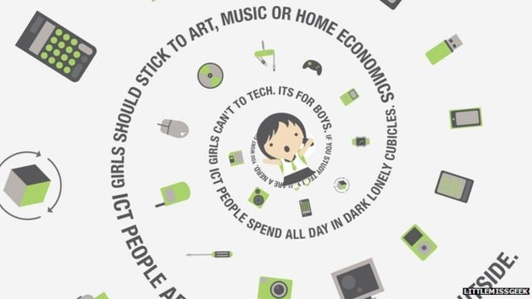

Slide 7
PI “pit stops”
In Year 1: COMP107 (Graduates for the Digital Society)
In Year 2:
COMP221 (Planning your career)
COMP208 (Group Software Project)
(Year in Industry or Year Abroad)
In Year 3: COMP390 (Honours Year Computer Science Project)
(In Year 4: 1st and 2nd semester projects)

Slide 8
COMP107: a project based approach
What you normally find on PI within a CS degree:
how to start becoming a computing professional
the bigger picture of computing
how to improve your transferable/employability skills
Often all is crammed in one module with lots of information
… which remains quite abstract and detached from the rest
University of Liverpool novel approach: PI “in action”
a practical project throughout the module to help crystallise notions

Slide 9
COMP107: a project based approach
Database Modelling
Communication &
Critical Thinking
Professional Issues

Slide 10
Reflections…
Database Modelling
Communication &
Critical Thinking
Professional Issues

