Slide 1
The Scientific Method
Paul Aplin
In making sense of our world, there should be few occasions in which we are forced to concede “It just is” or “It’s magic” or “Because I said so”
S Pinker

Slide 2
What is science?
Science is a systematic and logical approach to discovering how things in the universe work
Science is also the body of knowledge accumulated through the discoveries about all the things in the universe
The word ‘science’ is derived from the Latin word scientia, which means knowledge based on demonstrable and reproducible data
True to this definition, science aims for measurable results through testing and analysis
Science is based on fact, not opinion or preferences
The process of science is designed to challenge ideas through ‘research’
Source: www.livescience.com

Slide 3
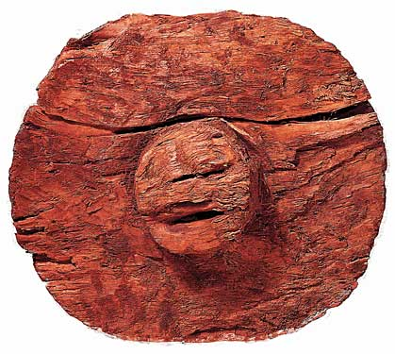
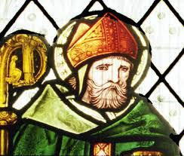
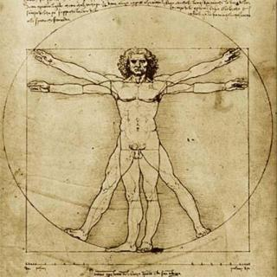
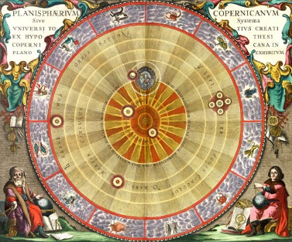
History of science
Prehistoric evidence of the discovery of fire, invention of the wheel and development of writing
1200s: Robert Grosseteste developed the framework for the proper methods of modern scientific experimentation, i.e. that an inquiry must be based on measurable evidence that is confirmed through testing
1400s: Leonardo da Vinci began his notebooks in pursuit of evidence that the human body is microcosmic, and gathered information about optics and hydrodynamics
1500s: Nicolaus Copernicus advanced the understanding of the solar system with his discovery of heliocentrism, the model in which the Earth and planets revolve around the sun
1600s: Johannes Kepler built upon those observations with his laws of planetary motion, while Galileo adopted the telescope to study the sun and planets and Isaac Newton developed his laws of motion

Slide 4
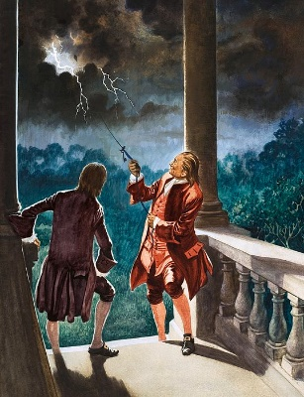
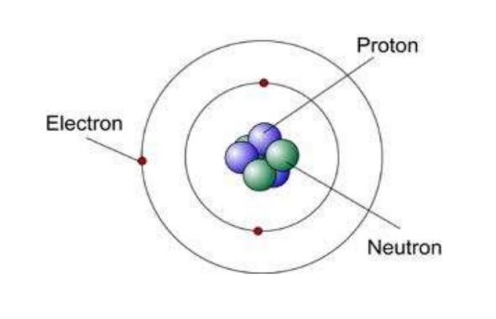
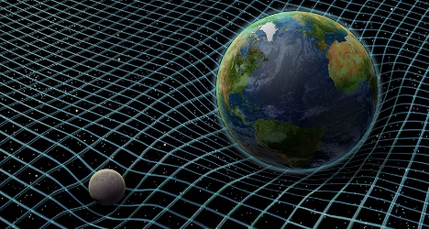
History of science (2)
1700s: Benjamin Franklin discovered that lightning is electrical and Antoine Lavoisier, dubbed the father of modern chemistry, developed the law of conservation of mass
1800s: Milestones included Alessandro Volta’s discoveries regarding electrochemical series, John Dalton’s atomic theory, Gregor Mendel unveiled his laws of inheritance, Wilhelm Conrad Röntgen discovered X-rays and Ohm’s law provided the basis for understanding how to harness electrical charges
1900s: Einstein’s two theories of relativity dominated the beginning of the 20th century, medicine forever changed with the development of the polio vaccine in 1952 by Jonas Salk, and the following year James Watson and Francis Crick discovered the structure of DNA
2000s: The 21st century saw the first draft of the human genome completed, leading to a greater understanding of DNA

Slide 5
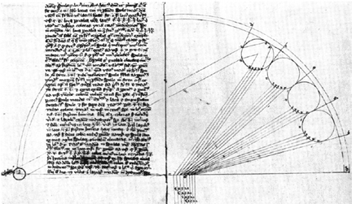
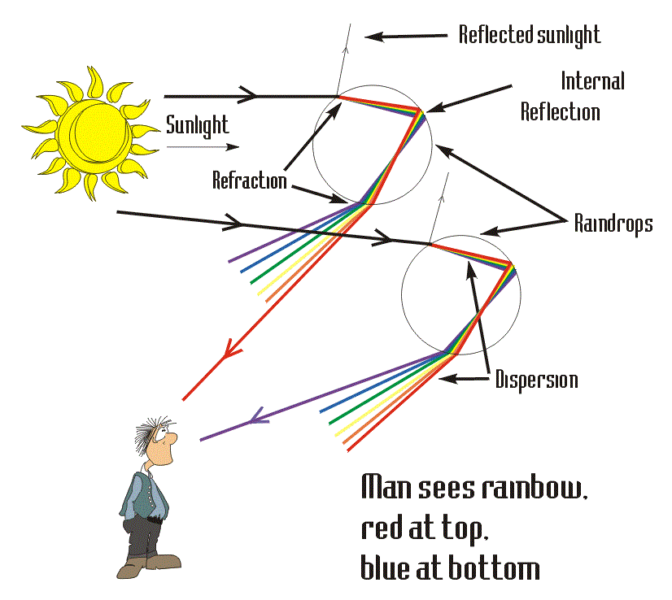
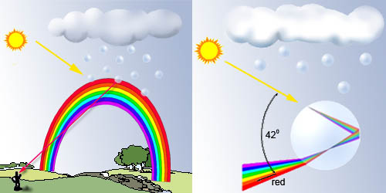
Theodoric’s rainbow
Theodoric von Freiberg wrote a treatise on the rainbow, De iride, around 1310
This reported one of the first experiments in the history of science
Theodoric used a spherical flask of water as a model of a raindrop in a cloud
He determined the path that light follows from the Sun through the drop to the human eye
He observed that different colours appeared as the flask was raised or lowered
Theodoric concluded that one raindrop would send only one colour of light to the observer
The rainbow results from a combination of many drops of water in a cloud at different positions from a centre, where the drops at each distance from the center send a particular colour of the rainbow

Slide 6
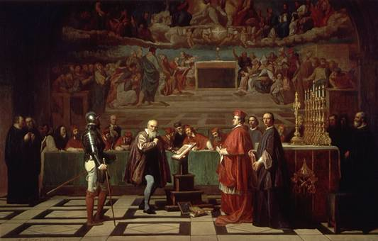
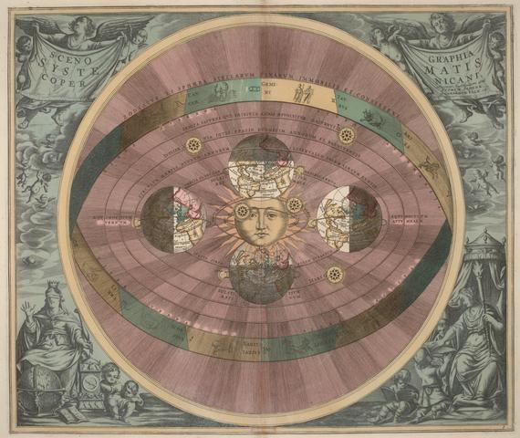
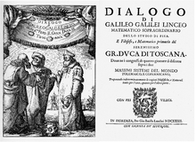
The Galileo affair
Galileo v Pope Urban VIII – one of science’s great feuds
Galileo was an advocate of heliocentrism, where Earth and the planets revolve around the Sun
Pope Urban and the catholic church preached geocentrism, where Earth is at the centre of the universe
In 1632 Galileo published his Dialogue Concerning the Two Chief World Systems, which defended heliocentrism
The Dialogue was written as a narrative involving a heliocentric scientist, Salviati, and a ponderous geocentrist named Simplicio (simpleton)
Pope Urban's own arguments for geocentrism were included in Simplicio’s dialogue
The Roman Inquisition tried Galileo in 1633 and found him "vehemently suspect of heresy", sentencing him to indefinite imprisonment
After Galileo’s death in 1642, Pope Urban refused permission for a public funeral and monument

Slide 7
Scientific research
When conducting research, scientists use the ‘scientific method’…
to collect measurable, ‘empirical’ evidence…
in an experiment related to a scientific ‘hypothesis’…
where the results aim to support or contradict a scientific ‘theory’
Richard Feynman – The Scientific Method

Slide 8
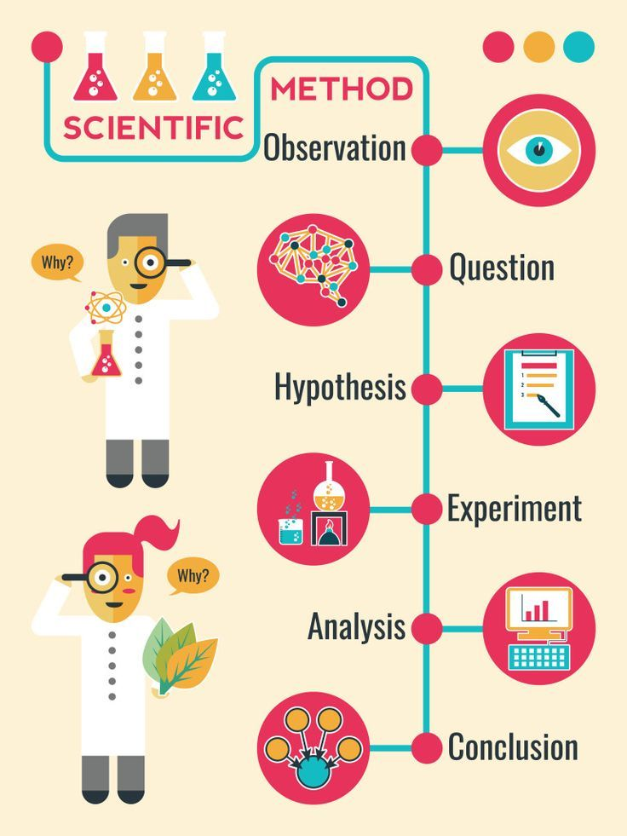
Steps in the scientific method
Make an observation or observations
Ask questions about the observations and gather information
Form a hypothesis from this information and make predictions based on that hypothesis
Test the hypothesis and predictions in an experiment that can be reproduced
Analyse the data and draw conclusions; accept or reject the hypothesis, or modify the hypothesis if necessary
Reproduce the experiment until there are no discrepancies between observations and theory

Slide 9
Key considerations
Research must involve deductive and/or inductive reasoning
A hypothesis must be testable and falsifiable
An experiment should include a dependent variable and an independent variable
An experiment should include an experimental group and a control group

Slide 10
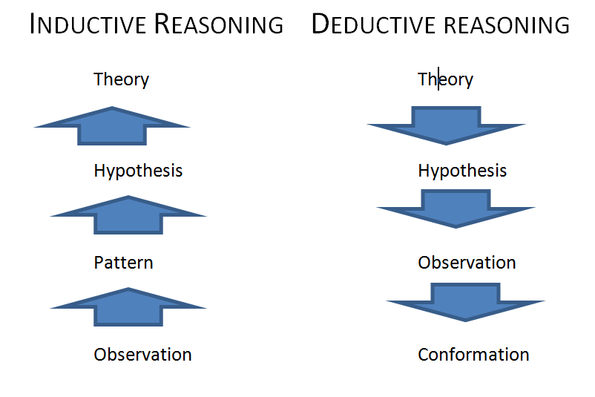
Deductive and inductive reasoning
Deductive reasoning starts out with a general statement, or hypothesis, and examines the possibilities to reach a specific, logical conclusion
Deduction is a top-down approach – from general (theory) to specific (observations)
Scientists use deductive reasoning to apply theories to specific situations
Inductive reasoning makes broad generalisations from specific observations
Induction is a bottom-up approach – specific to general
Scientists use inductive reasoning to form hypotheses and theories
Abductive reasoning starts with an incomplete set of observations and proceeds to the likeliest possible explanation
Scientists use abductive reasoning to form hypotheses to be tested

Slide 11
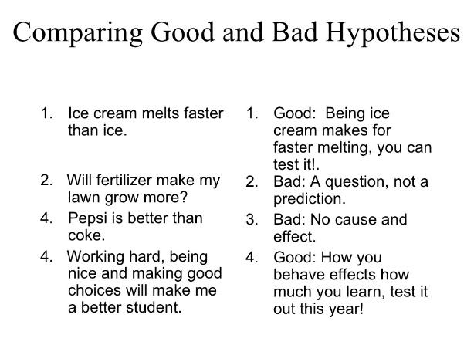
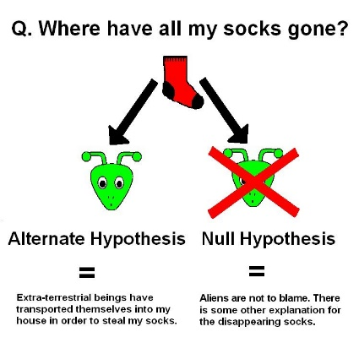
Scientific hypotheses
A scientific hypothesis is the initial building block in the scientific method
A hypothesis can be considered an ‘educated guess’ based on prior knowledge and observation
Hypotheses should be testable through carefully crafted experimentation or observation
Hypotheses should be falsifiable (i.e. have no pre-determined outcome)
A hypothesis may be written in the form of an if/then statement
An experiment commonly includes both a null hypothesis (where the prediction is false or has no effect) and one or more alternative hypotheses (where the prediction is true)

Slide 12
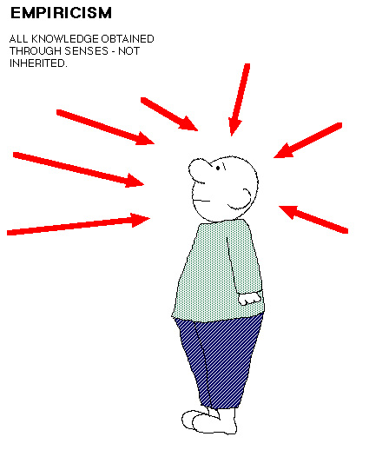
Empirical evidence
Empirical evidence is information acquired by observation or experimentation
Empirical evidence can be quantitative or qualitative
Quantitative research involves collection and statistical analysis of numerical data
Qualitative research, often used in the social sciences, involves collection and analysis of non-numerical data
Identifying empirical evidence:
Can the experiment be recreated and tested?
Does the experiment have a statement about the methodology, tools and controls used?
Is there a definition of the group or phenomena being studied?

Slide 13
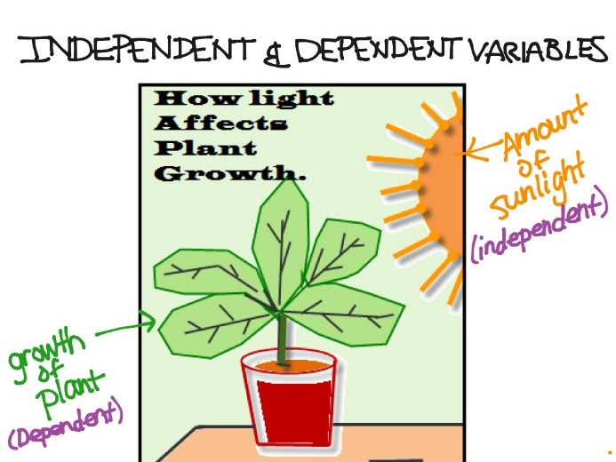
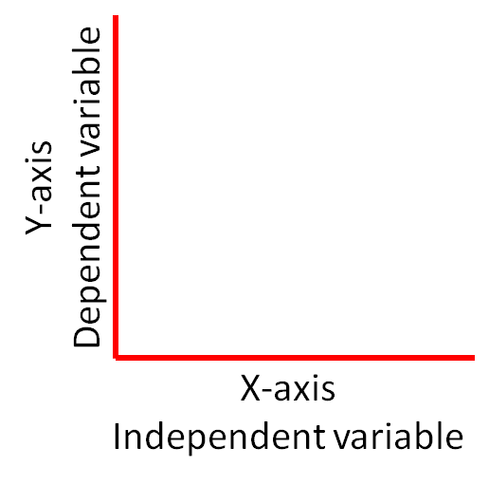
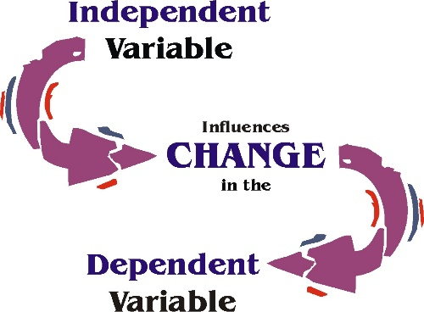
Dependent and independent variables
Scientific experiments generally include dependent and independent variables
The dependent (also ‘response’ or ‘explained’) variable represents the output or effect – this is the main object of study
The independent (also ‘explanatory’ or ‘predictor’) variable represents the input or cause
The dependent variable is studied to see if and how much it varies as the independent variable varies
An experiment can have multiple dependent variables but only one independent variable

Slide 14
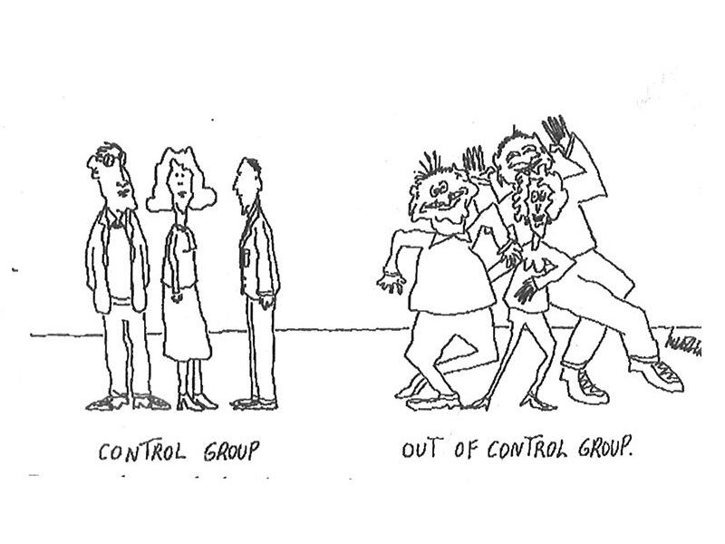
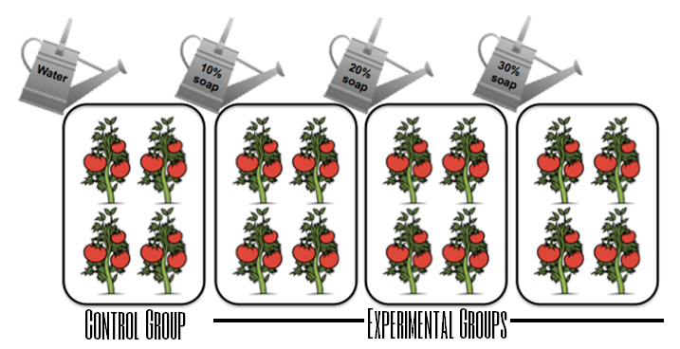
Experimental and control groups
Scientific experiments generally include experimental and control groups
The experimental group is the group to be tested – this is the main object of study
The control group is the group against which the experimental group is compared
Experimental treatments are applied to the experimental group, but the control group receives standard or no treatments

Slide 15
Reading
Feynman, R., 1964, The scientific method, www.youtube.com/watch?v=QdMmbaQHIs0, accessed 19 September 2017.
Henry, J., 2008, The Scientific Revolution and the Origins of Modern Science, 3rd edition, Palgrave Macmillan
livescience, 2017, www.livescience.com, accessed 19 September 2017. (Key source for this lecture.)
Parvin, P., 2010, Karl Popper, Continuum International Publishing Group. (See pages 34-48 on Popper’s epistemology. Available as an ebook through the library.)
Pinker, S., 2013, Science is not your enemy, The New Republic, www.newrepublic.com/article/114127/science-not-enemy-humanities, accessed 19 September 2017.
Valiela, I., 2009, Doing Science: Design, Analysis, and Communication of Scientific Research, 2nd edition, Oxford University Press.

Slide 16
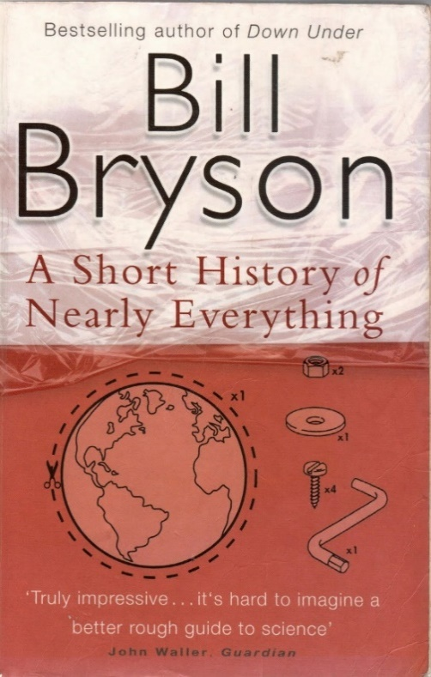
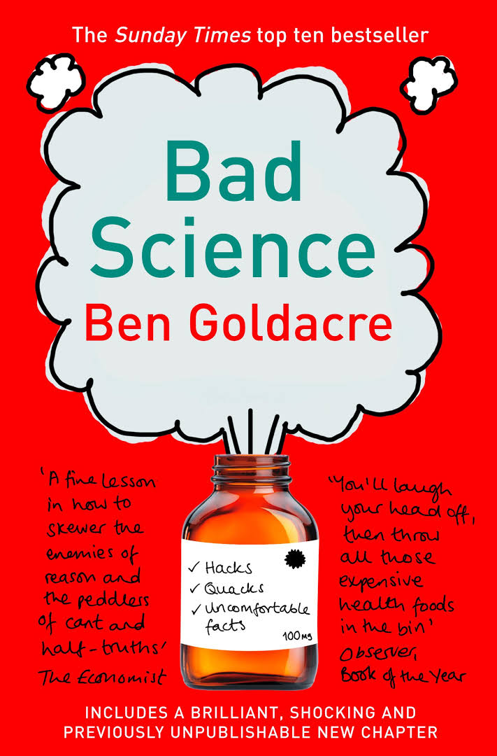
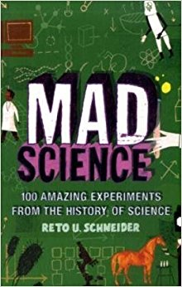
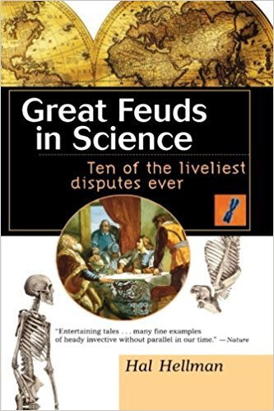
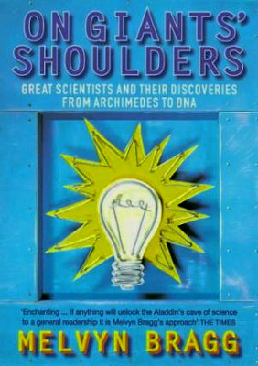
Reading (2)

Slide 17
Group work – Giant biographies
Research, discuss and present brief biographies of notable scientists
Choose a scientist from the list and research their life, career and achievements
How have they influenced the field of science, what was their most notable theory or experiment, what was the process of development or discovery, how was the work received by the scientific community and the public, how has the field progressed since then..?
Groups of 5 or so students
30 minutes research time
Few minutes’ presentation
The scientific giants
Archimedes
Galileo Galilei
Isaac Newton
Antoine Lavoisier
Michael Faraday
Charles Darwin
Jules Henri Poincaré
Sigmund Freud
Marie Curie
Albert Einstein
Francis Crick and James Watson
or choose one of your own…

