Slide 1
Dyscalculia
Task 2
PG Cert Education
(Inclusion and SEN)

Slide 2
Task 2
Dyscalculia

Slide 3
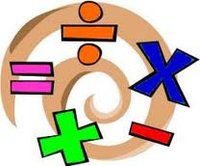
Task 2
Dyscalculia
Dyscalculia Overview
Best estimates indicate that somewhere between 3% and 6% of the population are dyscalculic.
These statistics refer to children who are ‘purely’ dyscalculic – i.e. they only have difficulties with maths but have good or even excellent performance in other areas of learning.
In comparison the BDA (British Dyslexic Association) suggest that around 4% of the population are severely dyslexic.
Dyslexics are not necessarily dyscalculic and vice-versa although they do share some similar features. Research suggests that 40-50% of dyslexics show no signs of dyscalculia. They perform at least as well in maths as other children, with about 10% achieving at a higher level.
Dyscalculia and dyslexia occur both independently of each other and together.
Further information can be found at:
http://www.bdadyslexia.org.uk/dyslexic/dyscalculia

Slide 4
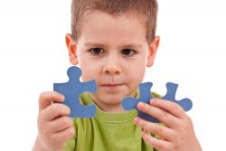
Task 2
Dyscalculia
Definitions of Dyscalculia
Below are two differing videos surrounding the definition of dyscalculia. Ronit Bird’s video is aimed at parents whereas the bottom video is a definition described by one of the leading professionals surrounding dyscalculia – Brian Butterworth.

Slide 5
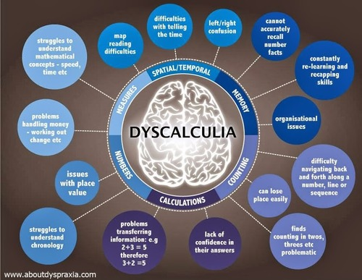
Task 2
Dyscalculia
Tell Tale Signs
Now you have viewed some of the theoretical viewpoints around Dyscalculia you will want to consider how to recognise this need in learners in your setting. If dyscalculia is not identified, problems can persist and affect the child’s life at school. This will result in increasing frustration and lowering of self-esteem.
Below you will find a link to the tell-tale signs for dyscalculia for learners from pre-school children to learners in High school.
Signs of Dyscalculia and Image of signs for dyscalculia poster
Read through the tell-tale signs and reflect on learners in your setting.

Slide 6
Task 2
Dyscalculia
What does it feel like?
Here are two differing perspectives on what it is like to live with dyscalculia.

Slide 7
Task 2
Dyscalculia
What does it feel like?
Use the Discussions area to reflect on the readings, video clips and case studies related to Dyscalculia with others in your group and consider the following questions:
Do you recognise these traits in any child within your setting?
Do external barriers exist in your setting for a learner with Dyscalculia?
How well do staff understand Dyscalculia in your setting?

Slide 8
Task 2
Dyscalculia
External Barriers
In Module 1 you considered external barriers to learning for pupils in your setting. These are the things external to the child which impact on their ability to access the curriculum. Things such as teaching style, grouping of children, style and locations of interventions, staff attitudes, skills, physical environment and expectations can all be external barriers to a pupil’s learning.
From your reading and reflections so far you will have already begun to consider what the external barriers to learning may be for a learner with dyscalculia.
Here you will find a summary of some of the external barriers which can impact on a dyscalculic learner
Barriers to learning for learners with Dyscalculia

Slide 9
Task 2
Dyscalculia
Strategies to support learners
Here you will find some strategies for supporting learners with Dyscalculia.
Implications for learning and possible strategies
As you look at the strategies you can also reflect on your reading from this module as well as module 1 and consider any possible implications to inclusivity that may arise from implementing such strategies.

Slide 10
Task 2
Dyscalculia
Readings related to Dyscalculia
The readings below will give you the opportunity to learn more about Dyscalculia and give you a greater understanding of some of the key issues relating to this specific learning difficulty (SpLD). As you read you should begin to reflect on learners in your setting and your own practice. You should also begin to consider what possible external barriers to learning and participation might exist for pupils with this SpLD.
Readings for the module are accessible through the Search Library Catalogue or Reading List link on the left hand menu of your Course Content area.
If you choose Dyscalculia as the focus area of need for your final written reflection you will be expected to refer to the essential and recommended readings below.
Dyscalculia Essential Reading

Slide 11
Task 2
Dyscalculia
TASK 2 Dyscalculia – Identification of need, external barriers and the inclusivity of strategies
The tasks within Module 2 follow the same format for each area of need and have been designed in this way to assist you in choosing the area of need you will focus upon for your final written reflection.
You are asked to reflect on the reading you have considered for each of these areas of need, the case studies, tell-tale signs for identifying these needs and what the external barriers to learning and participation might be for pupils encountering these particular learning difficulties.
You are then asked to select one strategy for supporting a pupil with the particular needs we have focused on and reflect on ways in which this strategy could be argued to be inclusive and ways in which this strategy could be argued to be not inclusive.
At this point you should begin to gather your initial thoughts by completing the Dyscalculia section on the grid within your Assignment Template, an example of the grid can be found below.
Module 2 Task 2 - Dyscalculia

