Slide 1
PICO
The well built model for developing a clinical question

Slide 2
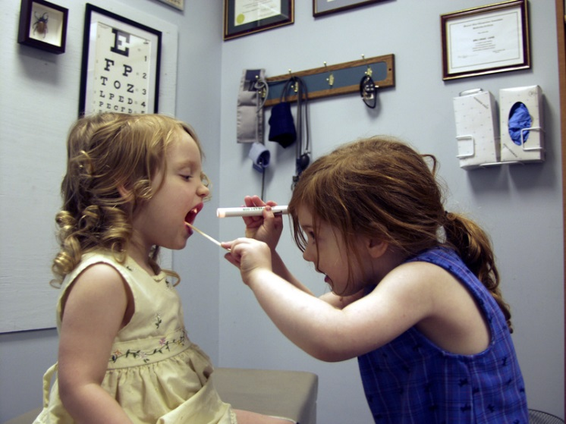
There are five steps to providing Evidence-Based Care (EBC):
1. ASK = Develop your answerable clinical question
2. ACQUIRE = Efficiently find the best evidence
3. APPRAISE = Critically evaluate the evidence for its validity and usefulness
4. APPLY = Use the results of the appraisal in your clinical practice
5. ASSESS = Evaluate your performance
Sackett DL, Straus SE,et al. Evidence Based Medicine: How to Practice and Teach EBM. 2nd Ed.
Churchill Livingstone: Edinburgh, 2000.

Slide 3
P = Patients, Population of interest
Who are the patients of interest?
Is there a particular age group, gender or population?
What is the health concern?
I = Intervention or Exposure
What therapeutic, diagnostic, preventative or other health care interventions are you interested in knowing about?
What health care management strategies are you interested in comparing?

Slide 4
C = Comparison of Interest
Is there a comparison to be evaluated against the intervention?
Only to be used if more than one intervention or if no intervention is a factor use outcome.
O = Outcome of interest
What is the desired outcome to be evaluated?
How will the patient or population be affected or not affected by the outcome.

Slide 5
The Well-Built Clinical Question: “PICO” Model
• Patient / Population / Problem (among _____)
• Intervention / Exposure (does _____)
• Comparison (versus ______)
• Outcome (affect _______)
NOTE:
This model works best for Therapy/Treatment & Diagnosis questions.
Notes:
Writing a good research question will help make the rest of the process of finding and evaluating the information a lot easier. PICO is a systematic way of finding information particularly good for Therapy / Treatment & Diagnosis questions.

Slide 6
P = Patient/Population of Interest
• Who are the patients of interest?
• Is there a particular age group, gender or population?
• What is the health concern?
Example:
For persons entering a health care facility……

Slide 7
I = Intervention or Exposure
• What therapeutic, diagnostic, preventive or other health care interventions are you interested in knowing more about?
• What health care management strategies are you interested in comparing?
Example: For persons entering a health care
facility, is hand rubbing with a waterless, alcohol based-solution…..

Slide 8
C = Comparison of Interest
• Is there a comparison to be evaluated against the intervention?
• Only used if more than one intervention or if no
intervention is a factor.
Example: For persons entering a health care
facility, is hand rubbing with a waterless, alcohol-based solution, as effective as standard hand washing with antiseptic soap…..

Slide 9
O = Outcome of Interest
• What is the desired outcome to be evaluated?
• How will the patient or population be affected, or
not affected, by the intervention?
Example: For persons entering a health care facility, is hand rubbing with a waterless, alcohol-based solution, as effective as standard hand washing with antiseptic soap for reducing hand contamination?
Example from: DiCenso A, Guyatt G, Ciliska D. (2005). Evidence-Based Nursing: A Guide to Clinical
Practice. St. Louis, MO: Mosby.

Slide 10
Think about a situation that you have come across or might come across in nursing that you might want or need to research to make a clinical decision
For example:
A therapy/treatment situation or when someone is being given a diagnosis.
Notes:
The reason we need to do this it will help if we already have a scenario that we could later research.
Write the situation down, Discuss it with the person next to you and then a couple can share it with the group if they want to.
Warming up with the ebooks. Use the ebooks to find some background information on your topic.
It can be difficult to put together a well balanced research question that is why we are going to introduce using the PICO advanced search to help formulate the question.

Slide 11
Therapy/Treatment In________(P) what is the effect of _______ (I) on ________(O) compared with (c)
Therapy/Treatment In persons entering a health care facility (P) what is the effect of hand rubbing with a waterless, alcohol based solution (I) on reducing hand contamination (O) compared with hand washing with antiseptic soap (c)
Diagnosis
Are (Is) _______(I) more accurate in diagnosing _________(P)
compared with (c)
Diagnosis
Is a PKU test (I) done on two week old infant (P) more accurate in diagnosing inborn errors in metabolism (O) compared with PKU tests done at 24 hours of age (c)
Notes:
Here are some examples to show how you can build up the question. You can then use the key concepts and alternative keywords for search terms. Then in the database you can use the advanced search screen to combine your terms.

Slide 12
Is acupuncture a more effective method of quitting smoking, when compared to nicotine replacement therapy?
Notes:
PICO question

Slide 13
Patient/ Population/ Problem | Intervention | Comparison | Outcome
smoking | acupuncture | “Nicotine replacement therap*” | quit*
smok* (finds - smoke, smoker, smokers, smoking) | acupunct* | “nicotine gum” | stop*
tobacco |  | “chewing gum” | cease*
 |  | “nicotine patch*” | “smoking cessation”
 |  |  | cessation
Notes:
Suggested terms for searching.
Search each intervention separately. Remember to include alternative names or similar terms and combine with OR when searching.
Combine results for each intervention, therapy or diagnosis method with AND.
Add patient group, population or age as a limit to focus results if required.

Slide 14
Acknowledgement
Center for Health Policy & Clinical: Cincinnati Children’s

